Slide 1



How Good Are Distributed Allocation Algorithms for Solving Urban Search and Rescue Problems?
A Comparative Study With Centralized Algorithms
Presenter：Zheng-Xu Lin
Adviser： Tzuu-Hseng S. Li
Date：2022/06/06

Slide 2
Outline
II. Introduction
II. Problem Description
MCPSO for Task Allocation Method
Overview of Simulation Configurations
Experiment one
Experiment two
Conclusion

Slide 3
Introduction
Task allocation in applications of multivehicle systems is the key problem.
The test scenarios in this paper are based on the rescue aspect of search-and-rescue applications.
The distributed algorithms are often used to solve multivehicle task allocation problems, such as CBBA, PI, PI with softmax.
In this paper, we investigate the use of centralized algorithms to solve the multivehicle task allocation problems which is called MCPSO.

Slide 4
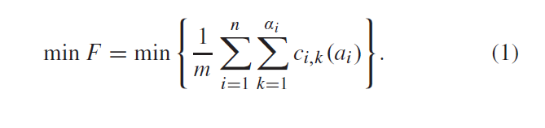
Problem Description
The goal of task allocation is to schedule and assign a sequence of tasks to each available vehicle without any conflicts among all vehicles.
The optimization criteria is the minimum cost.
Fig. 1. Rescue environment.

Slide 5
MCPSO For Task Allocation Method
Basic PSO
Priority Determination
Particle Coding and Decoding Methods
Lbest and Gbest Solutions Update Methods
Particle Velocity and Location Update Method
Insert Operation
Local Search Methods
Local Optimum Avoidance

Slide 6
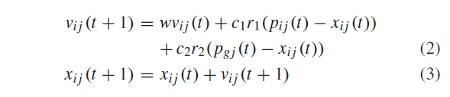
A. Basic PSO

Slide 7
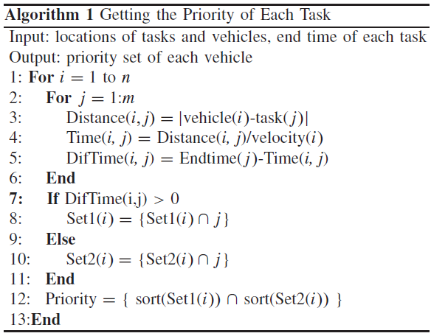
B. Priority Determination
The priority is determined by the time difference between the end time and the travel time from the vehicle to a location.

Slide 8

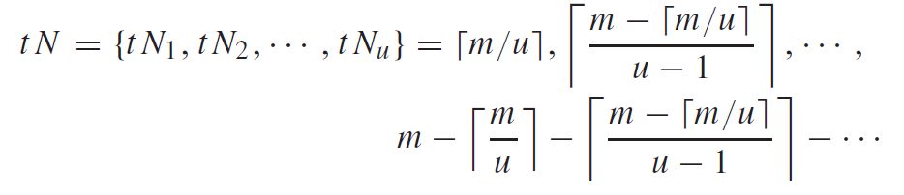
C. Particle Coding and Decoding Methods
The coding of a particle:
The task numbers for each type:
ex: m=13, u=3
tN=[5,4,4]

Slide 9
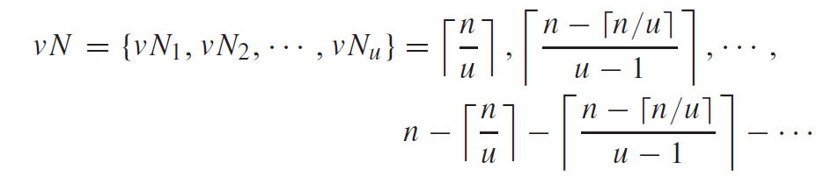
C. Particle Coding and Decoding Methods
The number of vehicles for each type:

Slide 10
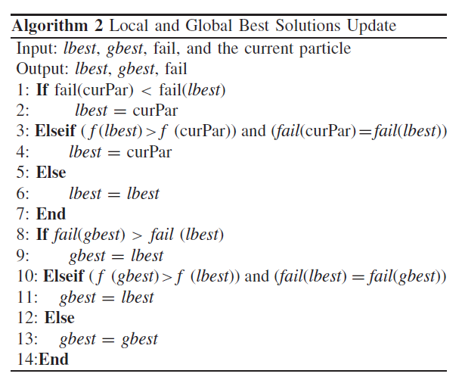
D. Lbest and Gbest Solutions Update Methods

Slide 11
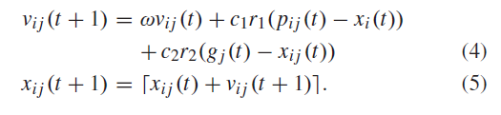
E. Particle Velocity and Location Update Method
By contrast:

Slide 12
F. Insert Operation
First, the number of tasks assigned to each vehicle is calculated.
Second, determine whether the smallest number of tasks assigned to a vehicle is lower than [m/n]
If yes, delete the last task in the task list of the vehicle with the largest number of tasks, and insert it into the vehicle with the smallest number of tasks.
Repeat the above-mentioned steps until the smallest number of tasks assigned to a vehicle is equal to [m/n].

Slide 13
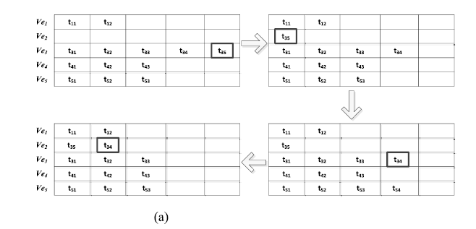

F. Insert Operation

Slide 14
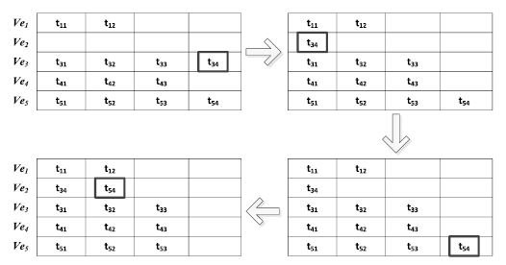
F. Insert Operation

Slide 15
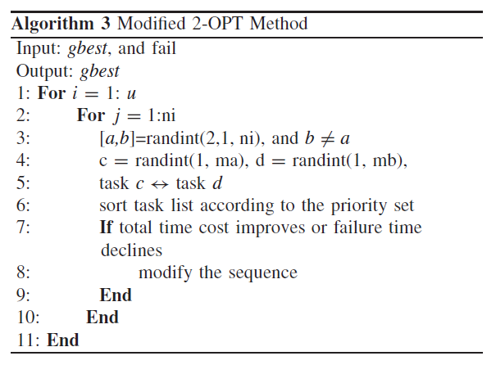
G. Local Search Methods

Slide 16
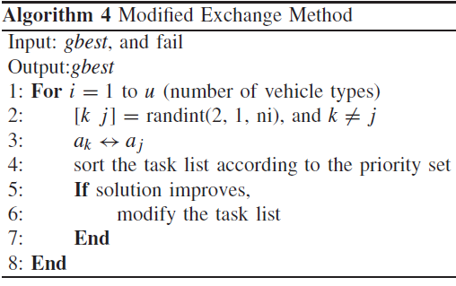
G. Local Search Methods

Slide 17
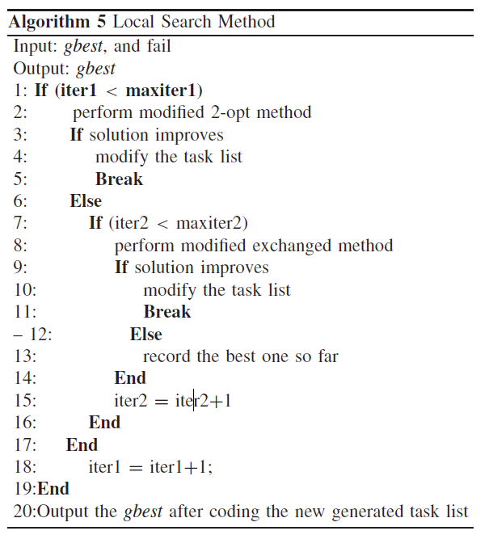
G. Local Search Methods

Slide 18
H. Local Optimum Avoidance
First, the global best solutions of the current and previous generations are compared and the difference between the two is calculated.
Second, count the number of consecutive gains that are smaller than a set threshold. The threshold number is to evaluate whether the optimum value is trapped into a local optimum. If the number is larger than the threshold, then the population is reinitialized.

Slide 19
Overview of Simulation Configurations
Compare MCPSO with CBBA, PI, Soft-max-based PI, GA, PSO
Two experiment are carried out

Slide 20
Experiment One
Test Scenario
4,6,8,10,12,14 and 16 vehicles are used respectively
The number of tasks is double the number of vehicles
The number of UAVs and helicopters is the same
-5000< x , y <5000 ； 0< z <1000
The helicopters: 30 m/s ； The UAVs: 50 m/s
The time window: 2000s
Delivering medicine: 300s ； Supply food: 350s
PSO parameters: w=0.5+(rand/2) ；c1=c2=1.494

Slide 21
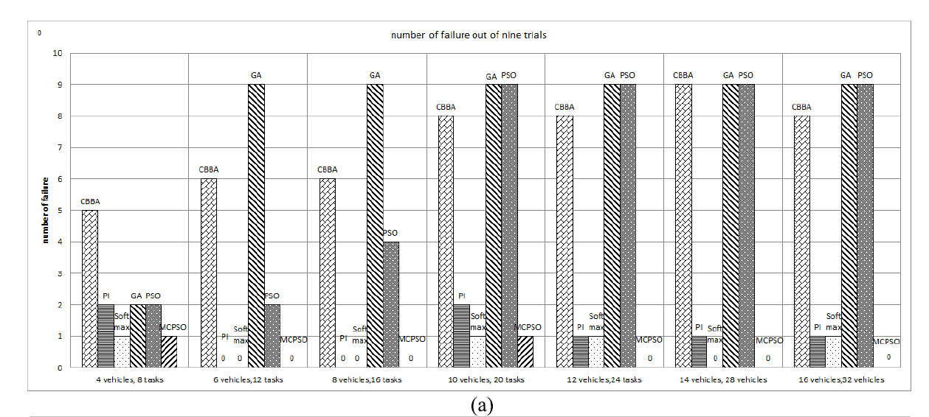

Experiment One
B. Simulation Results and Discussion

Slide 22
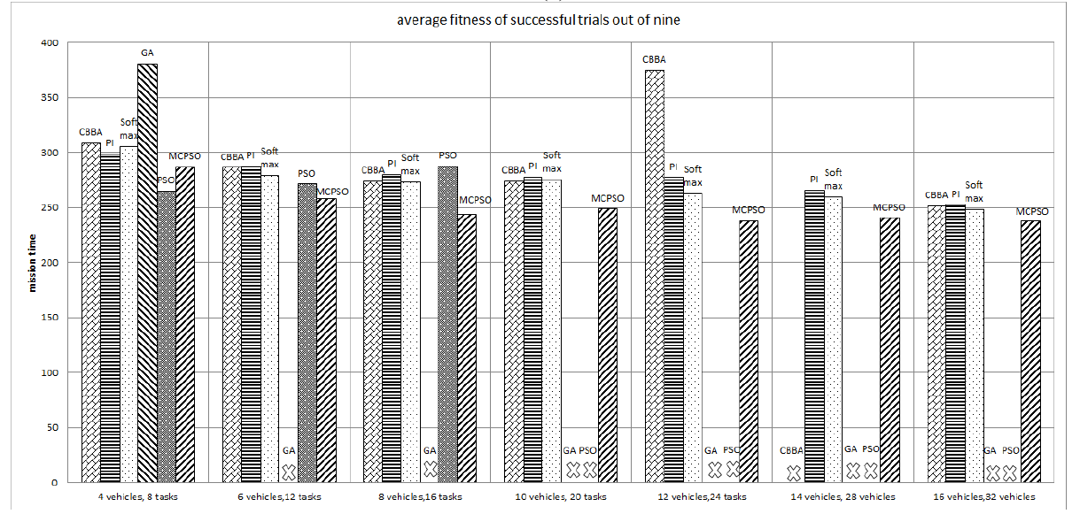
Experiment One
B. Simulation Results and Discussion

Slide 23
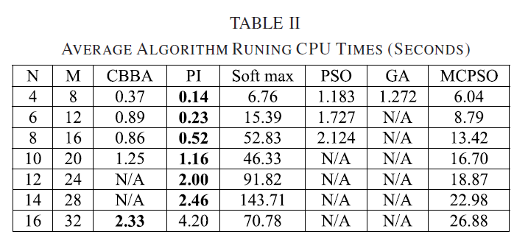
Experiment One
B. Simulation Results and Discussion

Slide 24
Experiment One
C. Result
CBBA: High failure rate, only solve 13/63 problems
PI: Run very fast and low failure rate, but fitness values are in the middle place and it can’t offer any best solution
PI with softmax: Better than PI, but it still can’t offer any best solution and it is the slowest of all the algorithms
PSO: Solve 18/63 problems and offer 3 best solution, but it can’t solve complex problems.
GA: Only solve 7/63 problems and none of them is the best solution and its running time is a bit longer than PSO
MCPSO: Only 4 problems are unsolved, and 56/59 solution are the best solutions

Slide 25
Experiment Two
Test Scenario
8 vehicles are used to carry out 20, 30, 40, 60, 80, and 100 rescue tasks.
-10000 < x , y < 10000 ； 0 < z < 1000
The time window: 20000s
MCPSO is only compared with PI and PI with softmax

Slide 26
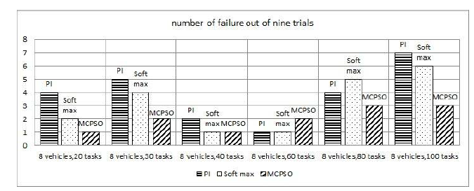

Experiment Two
B. Simulation Results and Discussion

Slide 27
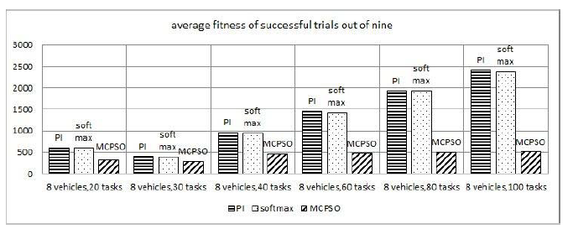
Experiment Two
B. Simulation Results and Discussion

Slide 28
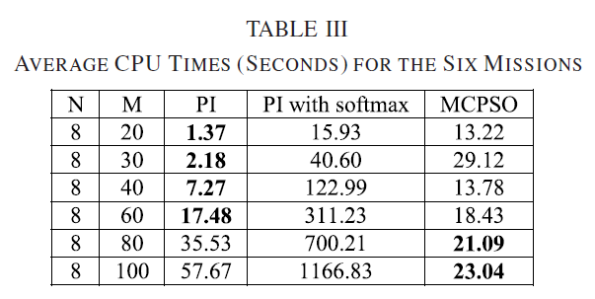
Experiment Two
B. Simulation Results and Discussion

Slide 29
Experiment Two
C. Result
PI: Solve 40/63 problems and its fitness value is worst
PI with softmax: Solve 45/63 problems and its fitness value is almost the same with PI’s, and it costs the longest time
MCPSO: Solve 51/63 problems and its fitness value is the best out of three, and its running time is acceptable

Slide 30
Conclusion
MCPSO can solve almost all scenarios in this paper. Even in complex scenarios, MCPSO only fails 10 times, while the PI fails 23 times, and PI with softmax fails 19 times.
These experiments demonstrate that the proposed centralized MCPSO solves more problems and with better solutions than state-of- the-art distributed algorithms.
MCPSO can be used as a benchmark for distributed algorithms for determining the performance gap, which will guide further development.

Slide 31
Thanks for your attention.

